Slide 1


ONLINE EXAMINATION SYSTEM
Business intelligence track
Mansoura branch
Group(4)

Slide 2
WHO WE ARE?
Samar Elbadry
Salma Malh
Momen Said
Ahmed Elgohary
Hala Hamdi

Slide 3
PROJECT PHASES
Phase 01
ERD
Phase 03
Reporting
Phase 02
Mapping
Initial data
Stored Procedures
Design Apps
Dashboards
SDLC Methodology
Waterfall
Agile

Slide 4





Project Timeline methodology
Scope Meetings
We used waterfall methodology then we moved to scrum agile.
We argued about how is project must go, and every member knew her/his role.
Analyzing the requirements was our priority to meet the output (products) with it.
Confirming the technology and put our first steps was our second one.
Database building
Designing ERD and Mapping.
Setting our tables and determine the primary and foreign keys.
Apply it on SQL server beside put our initial data to fill it.
Requirements Engineering
Implementation
Testing & Reporting
Design our Apps UI to know what procedures we need. Build our backend apps using C# and T-SQL.
Test our code and made sure that apps runs correctly.
Build our reports and dashboards to show them in the Instructor’s app.

Slide 5

TECHNOLOGIES USED
SQL Server
SSRS
C#
Visual Studio
Power BI
T-SQL
Axure (mapping and ERD)

Slide 6
PRODUCTS
ER Diagram
Mapping
77 Stored procedures
6 Reports
6 Dashboards
2 Apps
13 window forms for app
Documentation

Slide 7
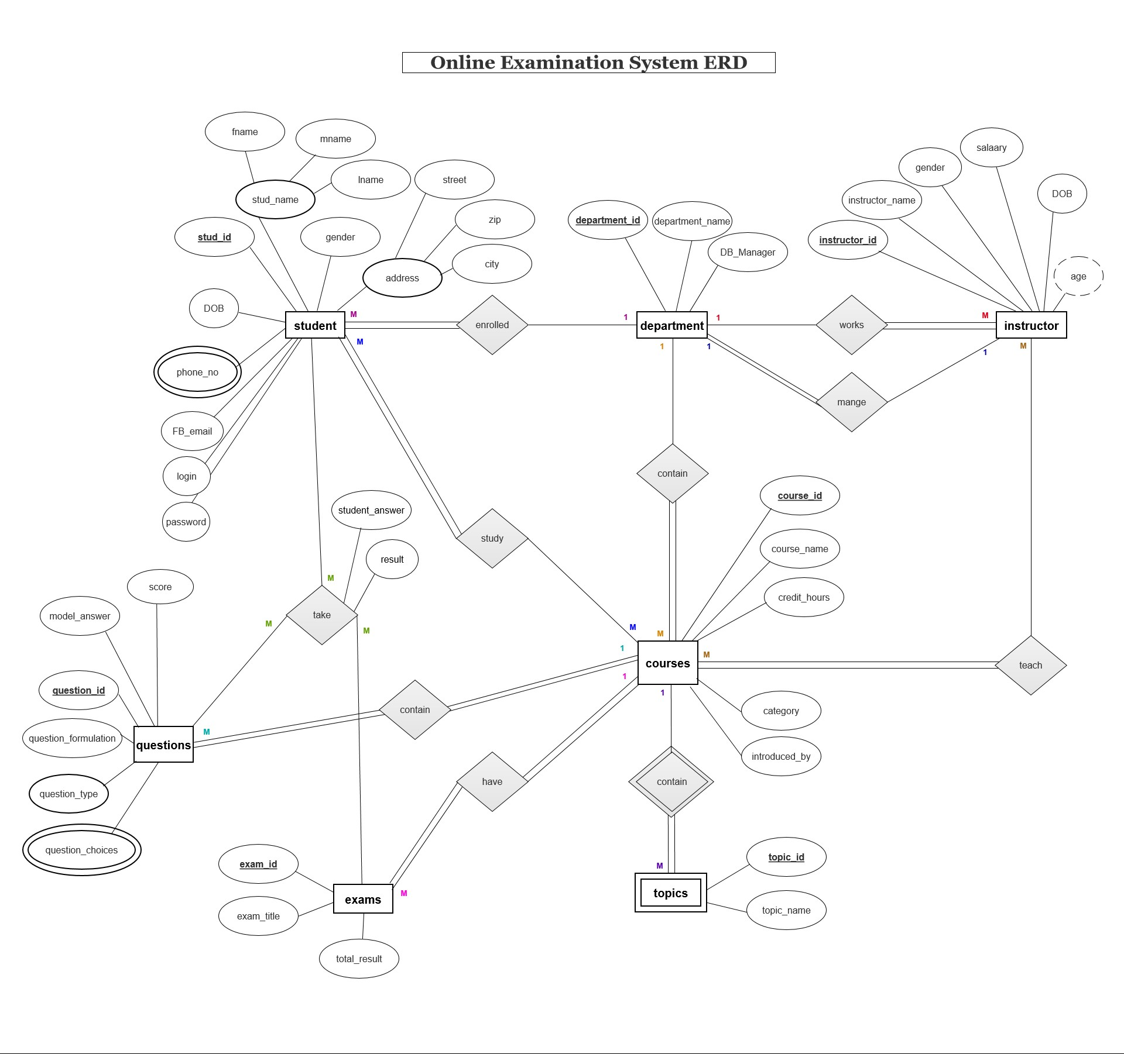
ERD

Slide 8
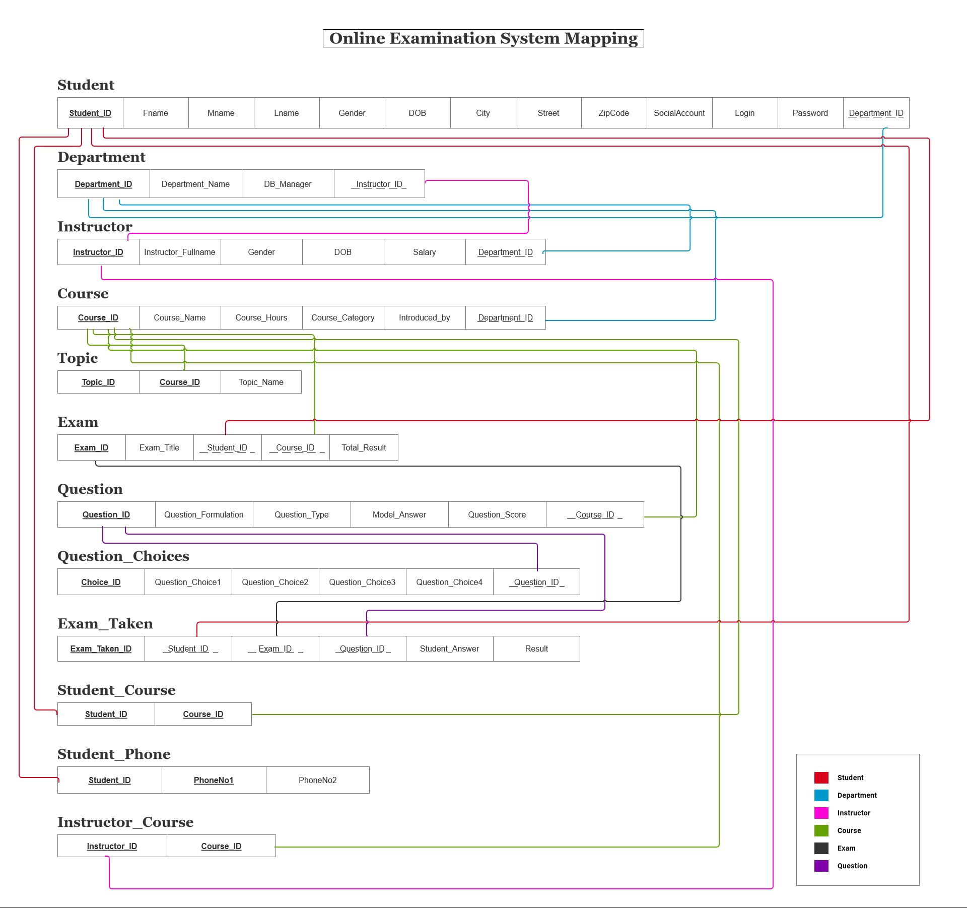

Slide 9
Exam Desktop Application
Initializing the app
After registration, the student can login normally
Login form (1st form)
Registration form (2nd form)
If the student uses the app for the first time
The student adds his data to be saved in the database
Message box (“invalid email or password”)
A button in the score form that closes the application
If =login false
Close button
If login = true
Shows the result in %
Result form (5th form)
Saving the exam questions, answers, and exam id in the database
The student chooses the course he wants to have exam in
Exam is here generated with random exam no.
Courses choosing form (3rd form)
Generating the exam
Exam form (4th form)

Slide 10
Instructors Desktop Application
Initializing the app
Login form (1st form)
Managers button
If login = true
Message box (“invalid email or password”)
instructors button
If login = false
Managers form
Generates 6 reports
If login = true
Instructors form
Generates 4 reports

Slide 11
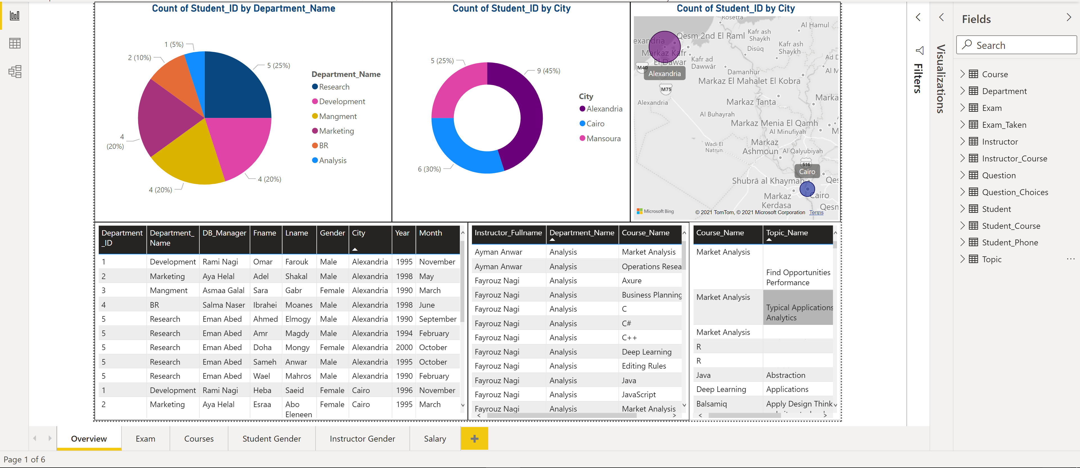
DASHBOARDS

Slide 12
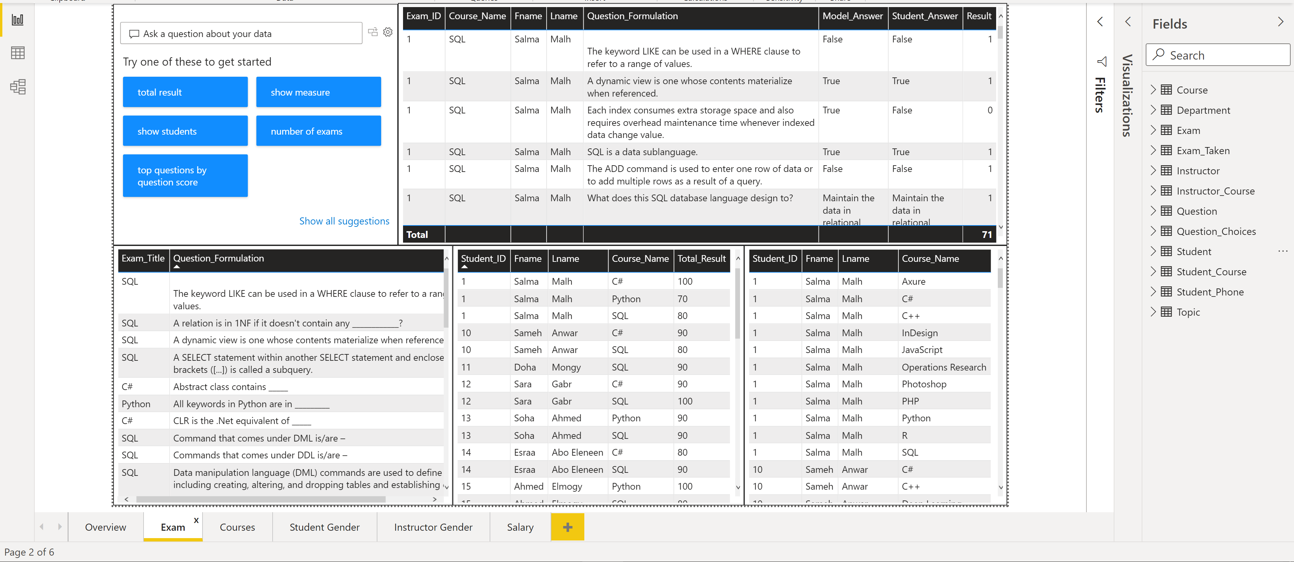

Slide 13
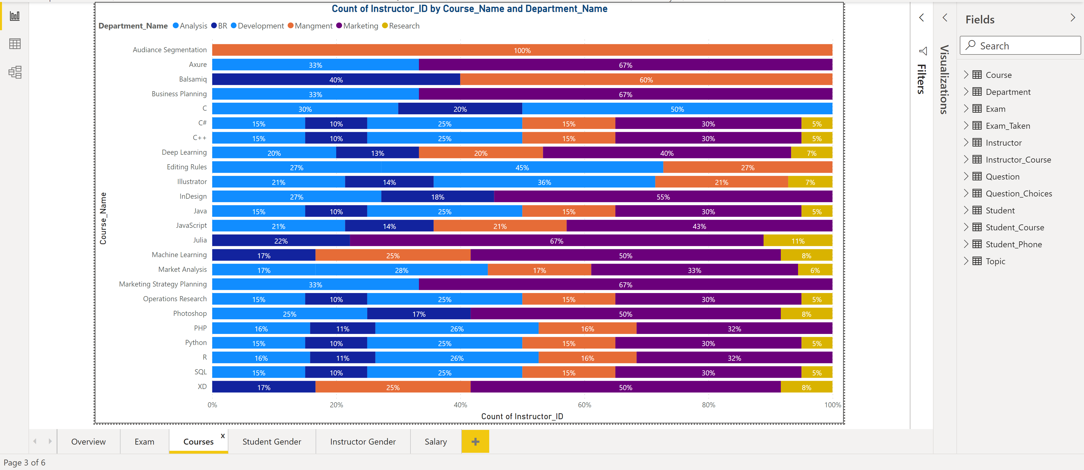

Slide 14
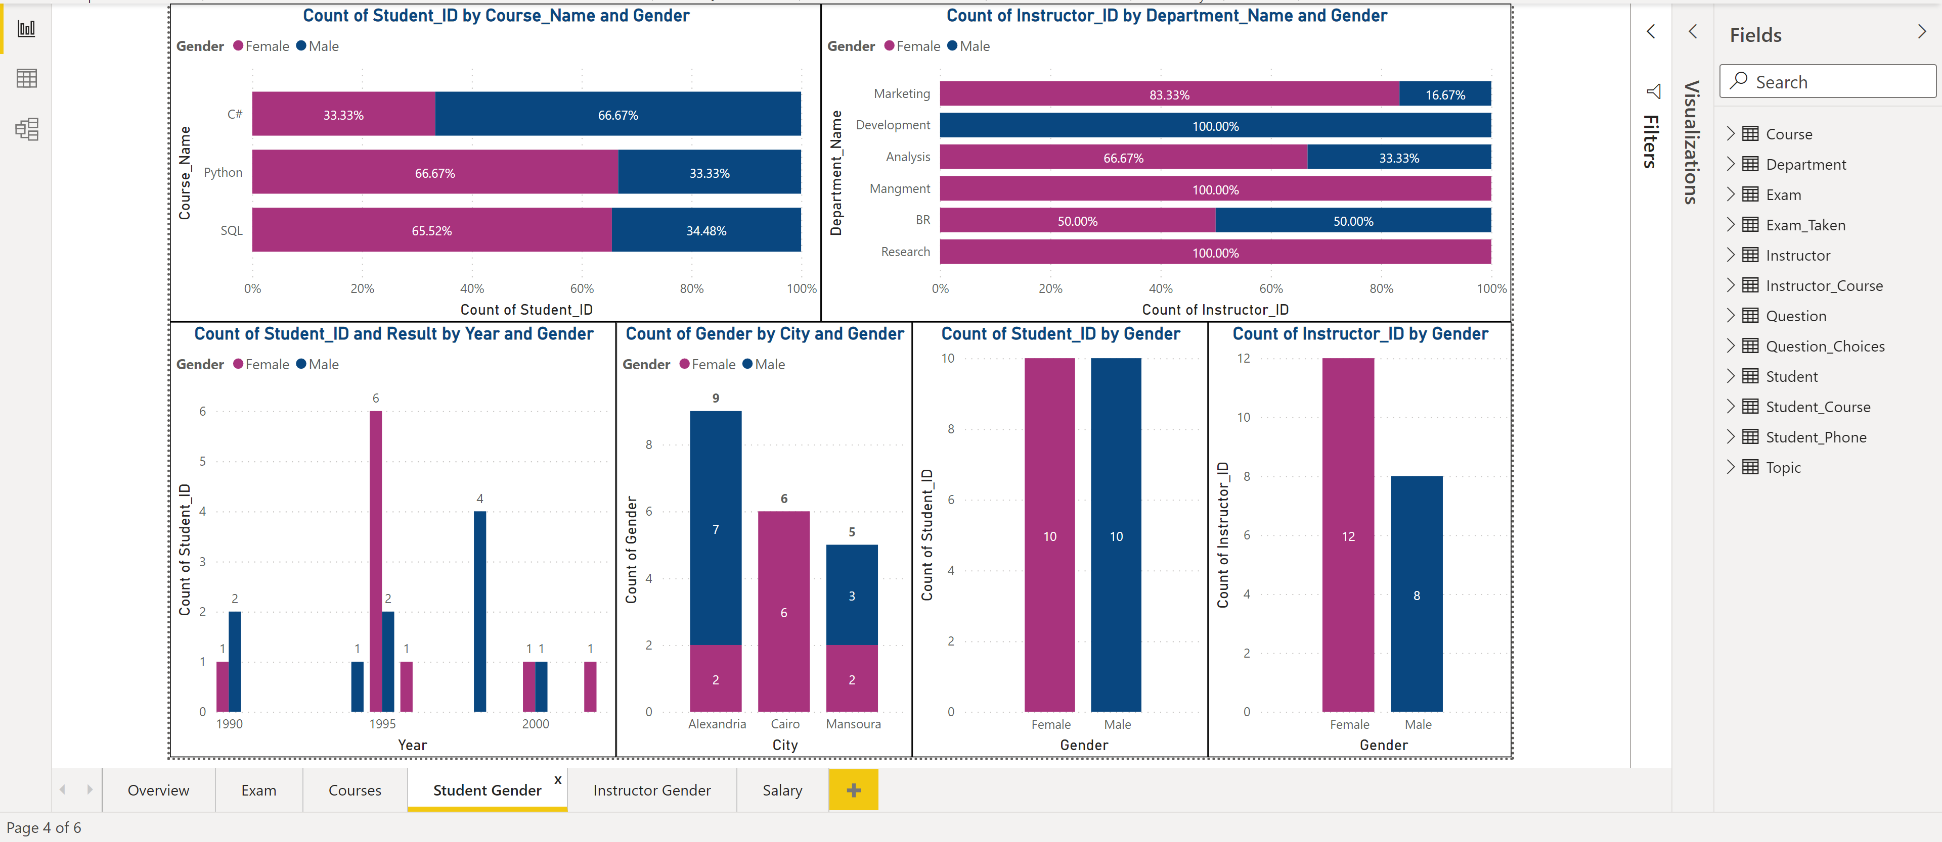

Slide 15
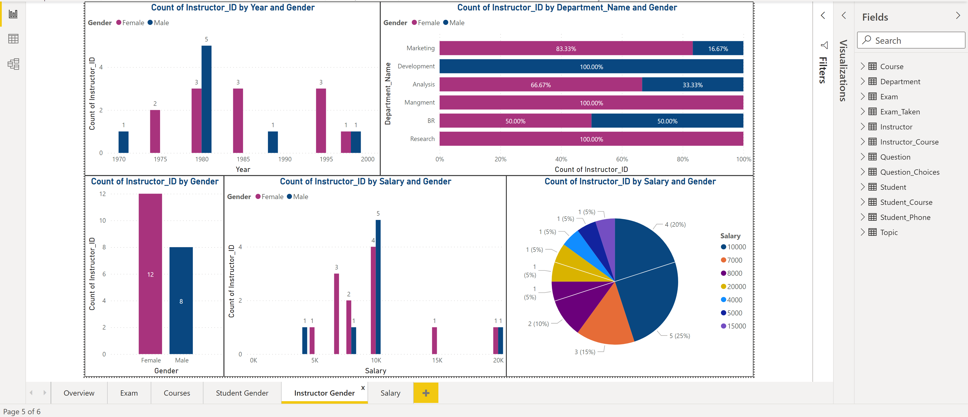

Slide 16
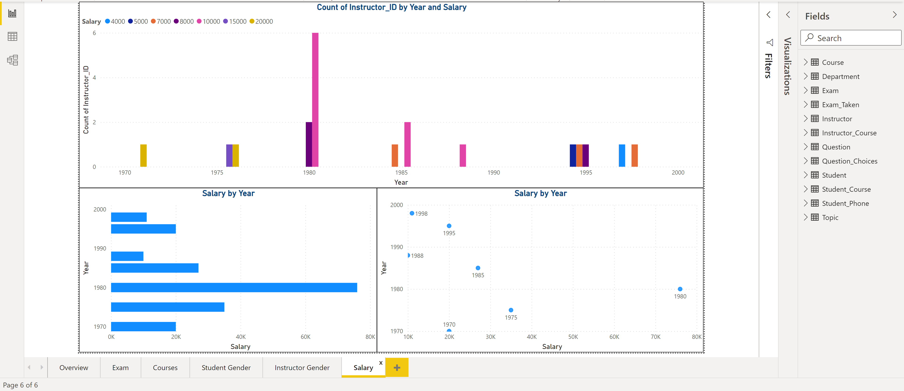

Slide 17
ANY QUESTIONS..?

